Slide 1
DND Management Tool Team Banshee

Slide 2
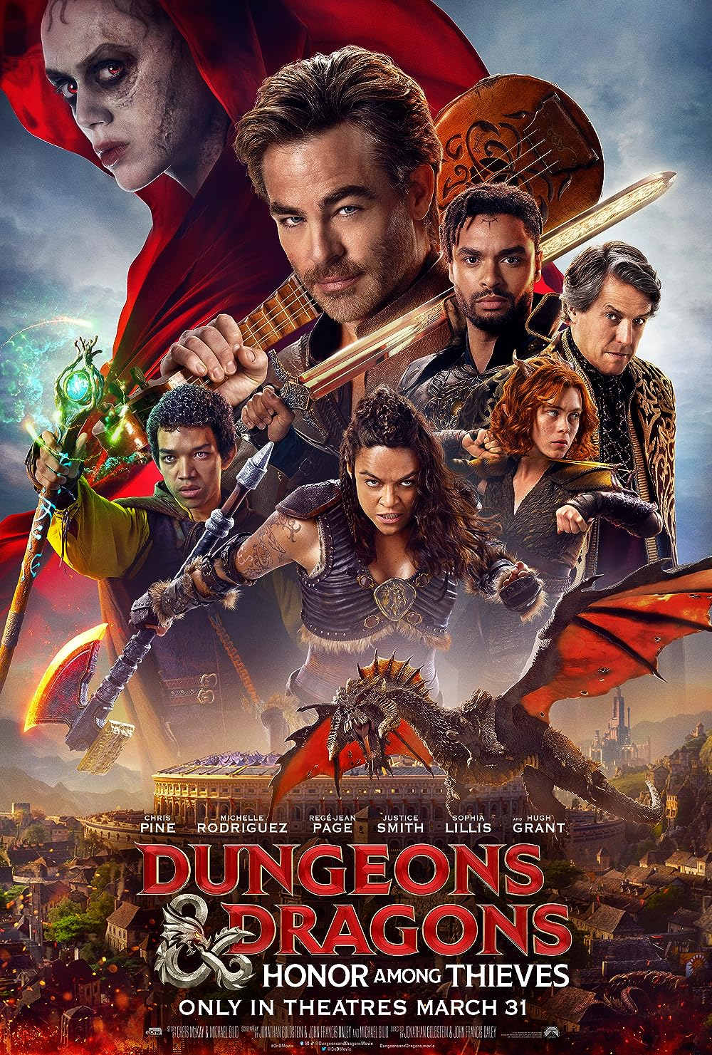
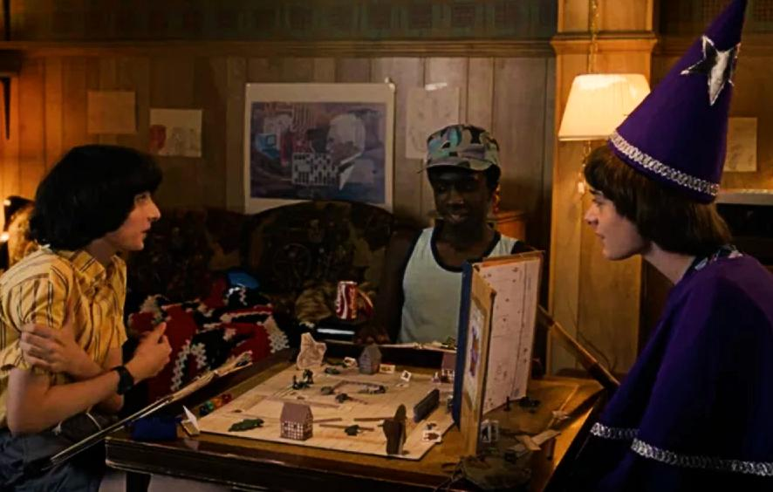
Dungeons & Dragons
Fantasy tabletop role-playing game
Consists of multiple players, and the game’s “storyteller”, the dungeon master
Stranger Things

Slide 3
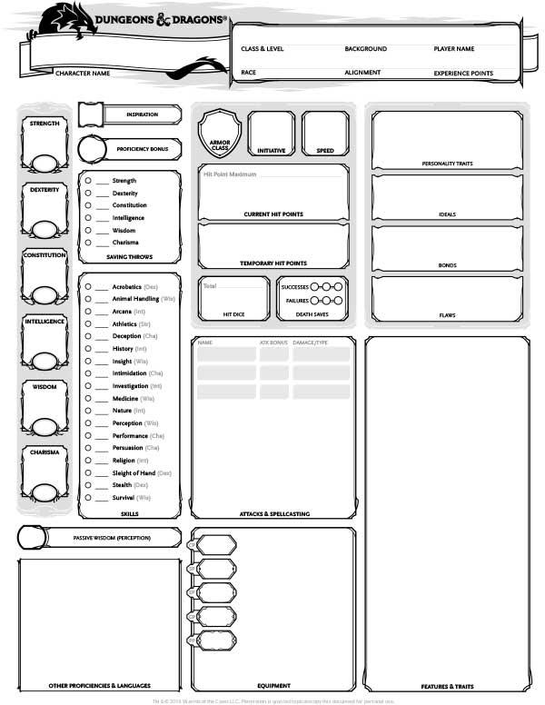
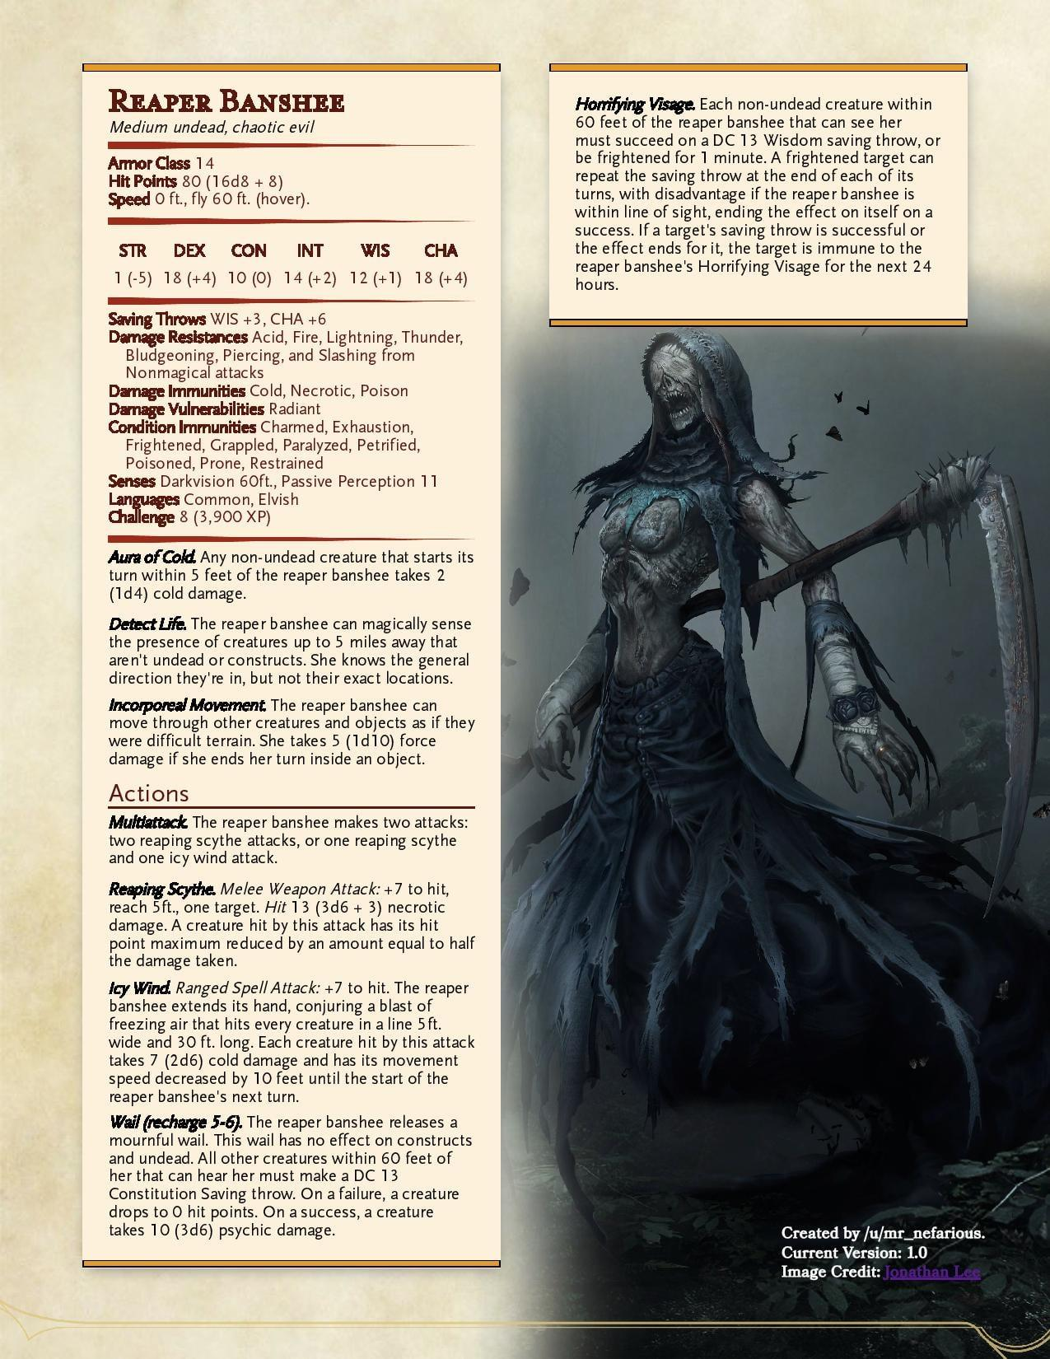
Project Goal
Help the Dungeon Master keep track of an extensive world

Slide 4
Project Overview
Manages session data
User authentication
Create sessions
Add entities to sessions
Manages multiple entities
Characters
Players
Monsters
Attacks
Towns
Notes:
We created a tool to help dungeon masters manage their dungeons and dragons sessions. The tool allows users to authenticate their identity and log in, create sessions for managing their D&D campaigns, and add entities to those sessions to keep track of everything happening in a session. The kinds of entities that can be added include characters (which are NPCs controlled by the dungeon master), players (which are controlled by the people playing in the campaign), monsters that the players will fight, the attacks that both the players and monsters will use, and the towns/locations that exist in the DM’s world. To create this tool, we used Flask for backend development, React for front end development, and we used a MySQL database to store the data.

Slide 5

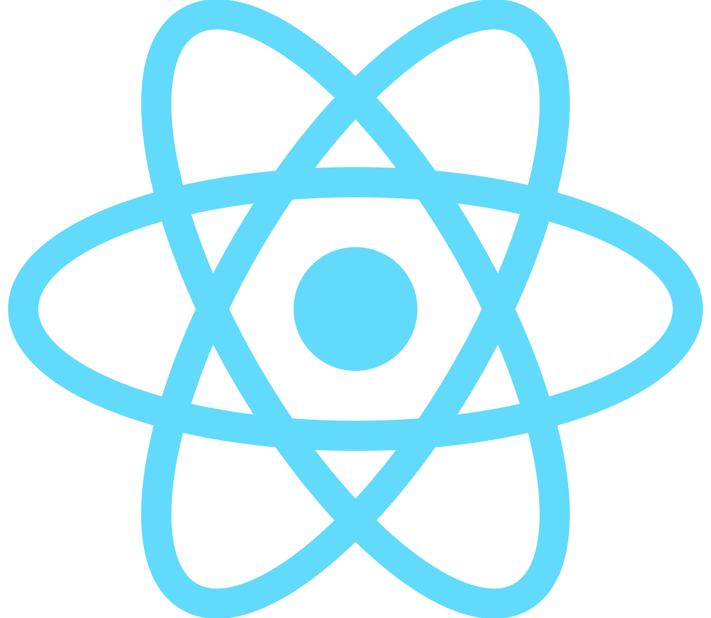

Project Overview
Frontend
Backend
Database
Notes:
We created a tool to help dungeon masters manage their dungeons and dragons sessions. The tool allows users to authenticate their identity and log in, create sessions for managing their D&D campaigns, and add entities to those sessions to keep track of everything happening in a session. The kinds of entities that can be added include characters (which are NPCs controlled by the dungeon master), players (which are controlled by the people playing in the campaign), monsters that the players will fight, the attacks that both the players and monsters will use, and the towns/locations that exist in the DM’s world. To create this tool, we used Flask for backend development, React for front end development, and we used a MySQL database to store the data.

Slide 6
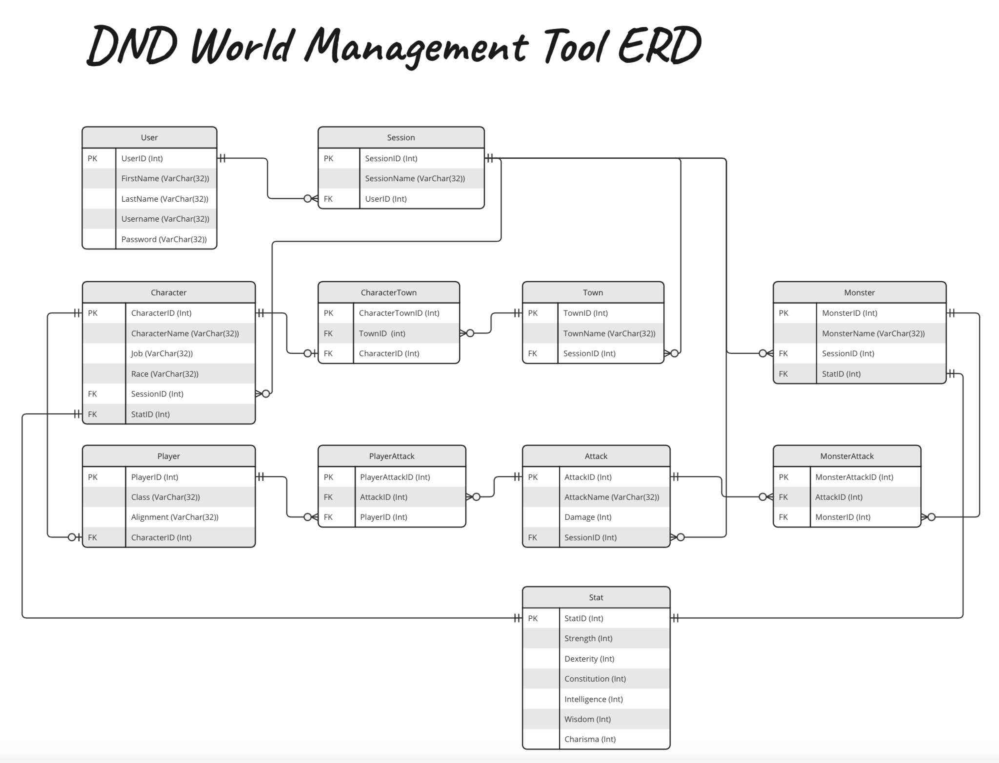
ERD
Notes:
This is our swimlane diagram for creating a new account. It starts with the User choosing the option to create a new account. They have to fill in fields for their first and last name, the username they want, and their password. After they select the “Create Account” button, their data is saved to the database. Additionally, the password they entered is hashed before it’s saved to the database for security purposes. Later, we will show a pre-recorded demo of the account creation process.

Slide 7
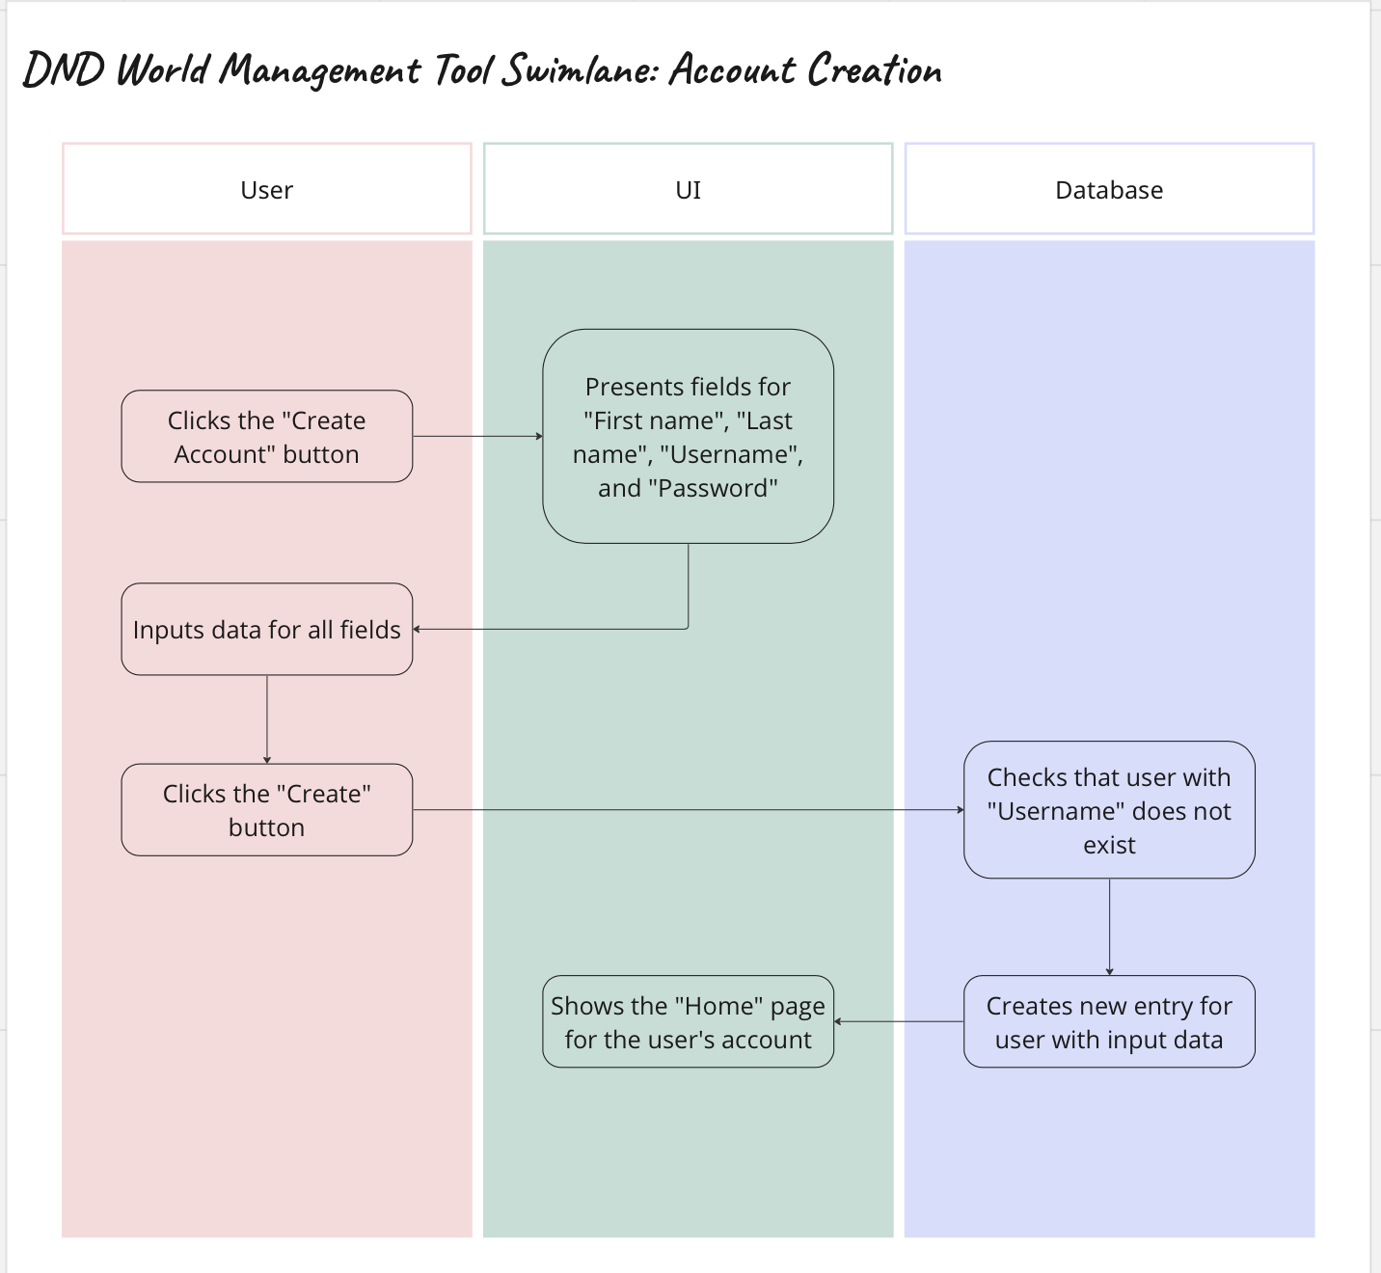
Swimlane
Notes:
This is our swimlane diagram for creating a new account. It starts with the User choosing the option to create a new account. They have to fill in fields for their first and last name, the username they want, and their password. After they select the “Create Account” button, their data is saved to the database. Additionally, the password they entered is hashed before it’s saved to the database for security purposes. Later, we will show a pre-recorded demo of the account creation process.

Slide 8
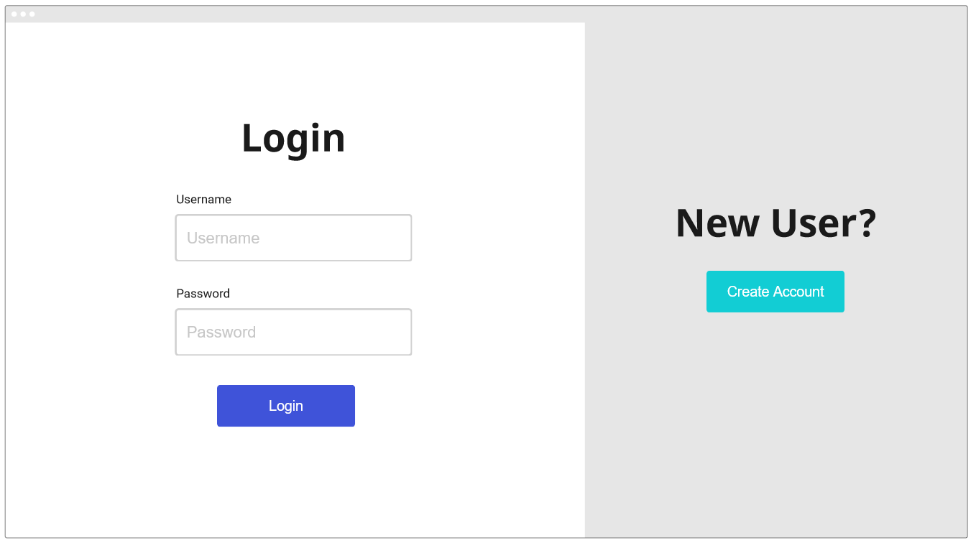
Initial Page Wireframe

Slide 9
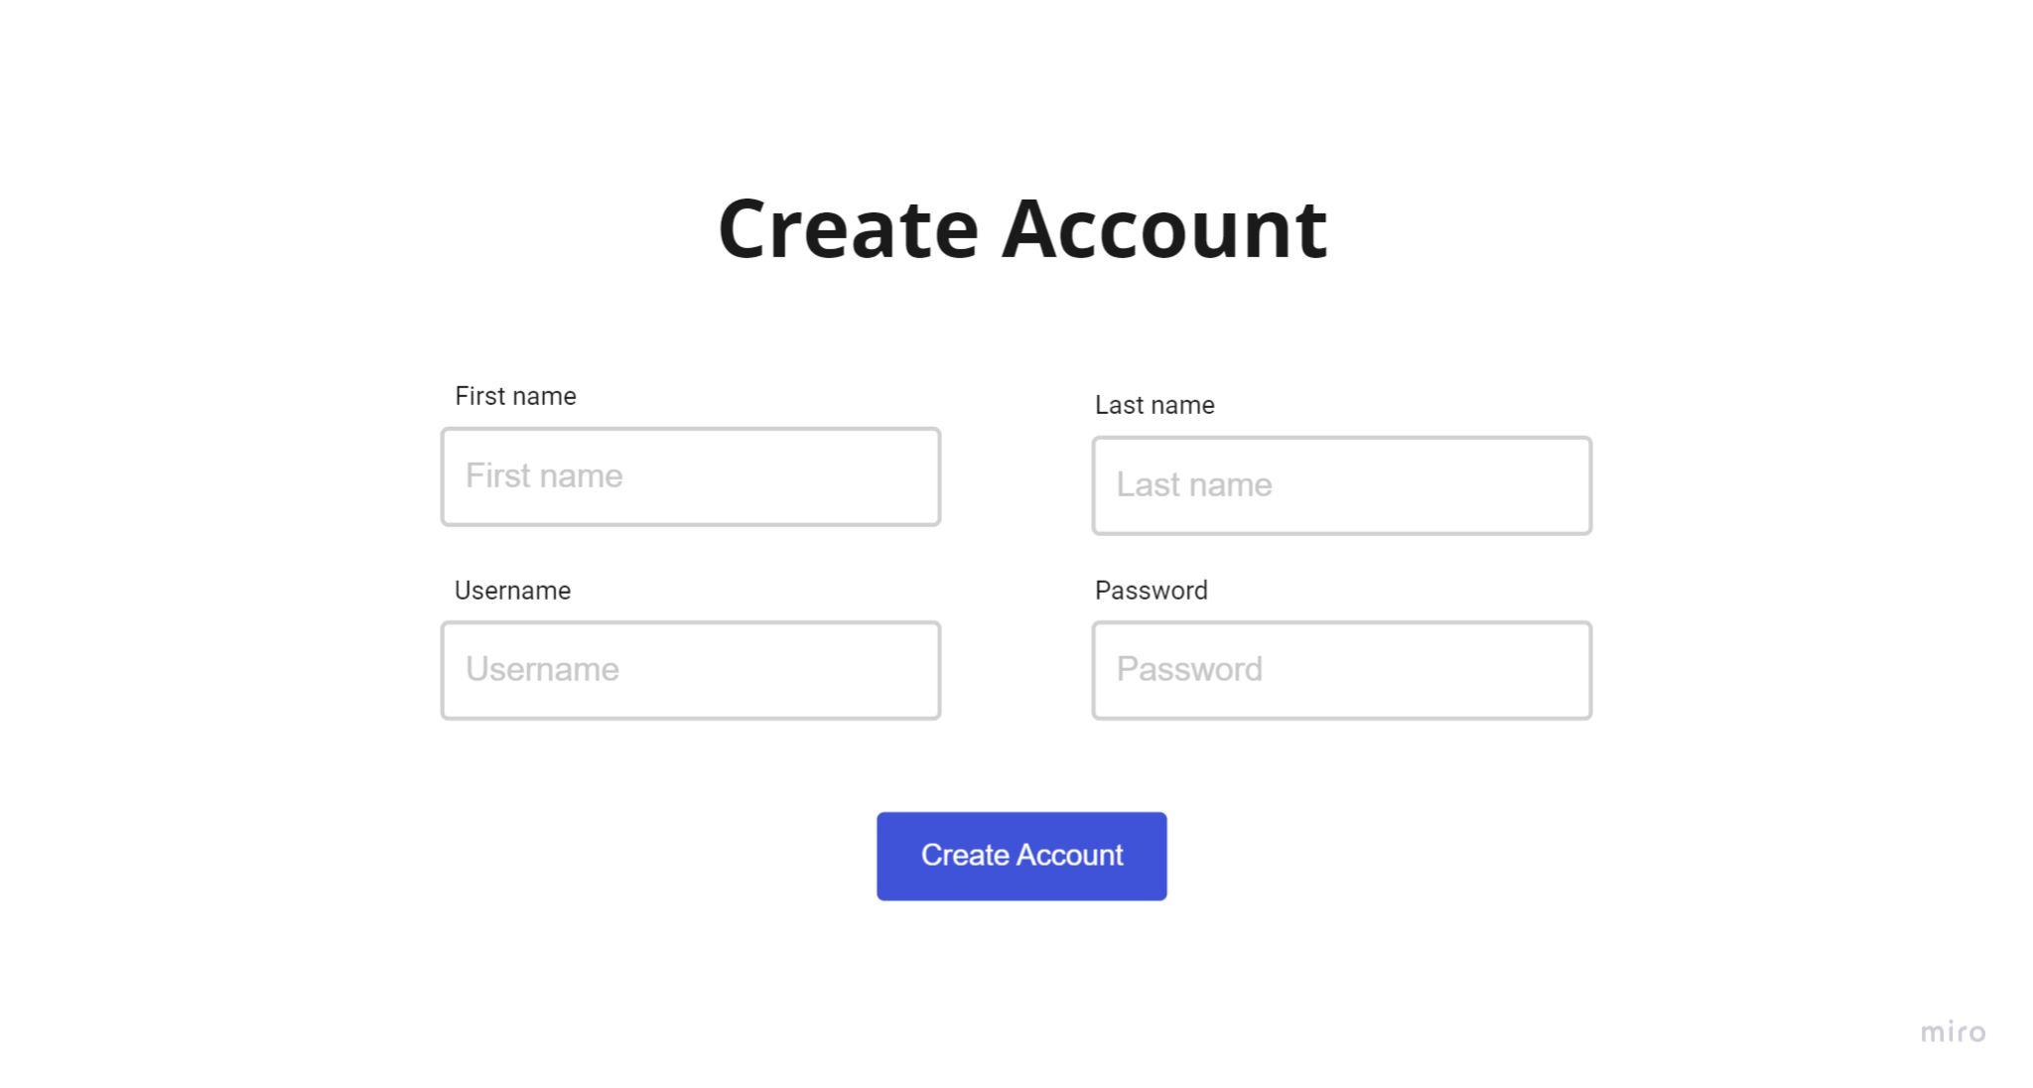
Create Page Wireframe
Notes:
This is our wireframe for what the account creation page should look like. We wanted the user to see clearly see where to enter their information and keep the page simple. As you will see in the demo in a moment, the account creation page matches its wireframe well.

Slide 10



Backend Structure
.env
server.py
db.py
classes.py
API
dnd_tool

Slide 11
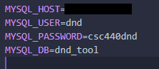
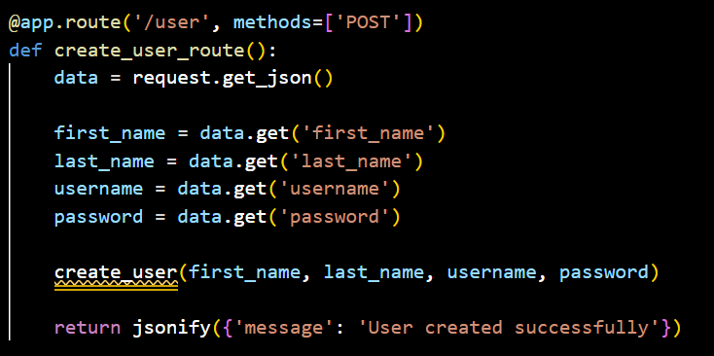
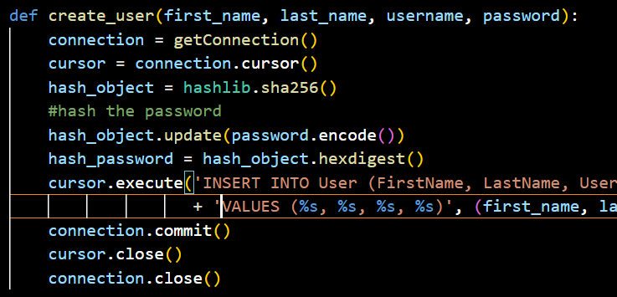
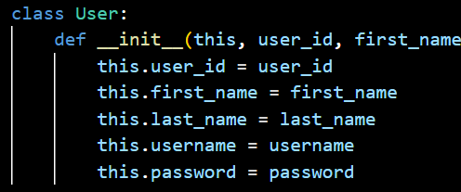
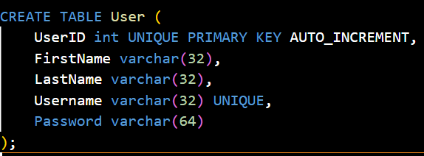
Backend Code
API

Slide 12

Demo

